Slide 1
Domain ML
Technology: Python
Detection of Cyber Attacks Using Artificial Intelligence

Slide 2
ABSTRACT
Cyber-physical systems(cps) have made significant progress in many dynamic applications due to the integration between physical processes, computational resources, and communication capabilities. However, cyber-attacks are a major threat to these systems. Unlike faults that occurs by accidents cyber-physical systems, cyber-attacks occur intelligently and stealthy. Some of these attacks which are called deception attacks, inject false data from sensors or controllers, and also by compromising with some cyber components, corrupt data, or enter misinformation into the system. If the system is unaware of the existence of these attacks, it won’t be able to detect them, and performance may be disrupted or disabled altogether. Therefore, it is necessary to adapt algorithms to identify these types of attacks in these systems. It should be noted that the data generated in these systems is produced in very large number, with so much variety, and high speed, so it is important to use machine learning algorithms to facilitate the analysis and evaluation of data and to identify hidden patterns. In this research, the CPS is modeled as a network of agents that move in union with each other, and one agent is considered as a leader, and the other agents are commanded by the leader.

Slide 3
INTRODUCTION
Recent advances in technology have led to the introduction of cyber-physical systems, which due to their better computational and communicational ability and integration between physical and cyber-components, has led to significant advances in many dynamic applications. But this improvement comes at the cost of being vulnerable to cyber-attacks. Cyber-physical systems are made up of logical elements and embedded computers, which communicate with communication channels such as the Internet of Things(IoT). More specifically, these systems include digital or cyber components, analog components, physical devices and humans that designed to operate between physical and cyber parts. In other words, a cyber-physical system is any system that includes cyber and physical components and humans, and has the ability to trade between the physical and cyber parts. In cyber-physical systems, the security of these types of systems becomes more important due to the addition of the physical part. Physical components including sensors, which receive data from the physical environment, maybe attacked and be injected incorrect data into the system. One of the most important challenges of a cyber-physical system, in its physical part is the presence of a large number of sensors in the environment, which collect so much data, with so much variety, and at high speed. Also, the connection between the sensors and the necessary calculations and the analysis of the obtained data will be among the main challenges. Therefore, one of the most important features of a cyber-physical system is to communicate between these sensors, compute and control the system

Slide 4
The security of cyber-physical systems to detect cyber-attacks is an important issue in these systems . It should be noted that cyber-attacks occur in irregular ways, and it is not possible to describe these attacks in a regular and orderly manner. In general, cyber attacks in cyber-physical systems are divided into two main types: denial of service(Dos) and deception attacks. In denial of service, the attacker prevents communication between network nodes and communication channels. However, in the deception attacks that inject false data to system, which are carried out by abusing system components , such as sensors or controllers and it can corrupt data or enter incorrect information into the system and cause misbehaving.
These attacks can be detected by system monitoring in the system. But if the attacker can plan a high-level attack to prevent himself from being identified, these attacks are called stealthy deception attacks, and other common methods of counteracting such attacks will not work. Therefore, it is important to be aware of the attacks that occur in order to respond in a timely manner to attackers. In other words, the security system must be aware of the attack, otherwise it will not be able to detect and control the attack. Cyber defense can be improved by using security analytic to search for hidden patterns and how to deceive.

Slide 5
LITERATURE SURVEY
[1] Kwon, Cheolhyeon, Weiyi Liu, and Inseok Hwang. ”Security analysis for cyber-physical systems against stealthy deception attacks.” In 2013 American control conference, IEEE (2013): 3344-3349
The security issue in the state estimation problem is investigated for a networked control system (NCS). The communication channels between the sensors and the remote estimator in the NCS are vulnerable to attacks from malicious adversaries. The false data injection attacks are considered. The aim of this paper to find the so-called insecurity conditions under which the estimation system is insecure in the sense that there exist malicious attacks that can bypass the anomaly detector but still lead to unbounded estimation errors. In particular, a new necessary and sufficient condition for the insecurity is derived in the case that all communication channels are compromised by the adversary. Moreover, a specific algorithm is proposed for generating attacks with which the estimation system is insecure. Furthermore, for the insecure system, a system protection scheme through which only a few (rather than all) communication channels require protection against false data injection attacks is proposed. A simulation example is utilized to demonstrate the effectiveness of the proposed conditions/algorithms in the secure estimation problem for a flight vehicle.

Slide 6
[2] Pajic, Miroslav, James Weimer, Nicola Bezzo, Oleg Sokolsky, George J. Pappas, and Insup Lee. ”Design and implementation of attack-resilient cyberphysical systems: With a focus on attack-resilient state estimators.” IEEE Control Systems Magazine 37, no. 2 (2017): 66-81.
Recent years have witnessed a significant increase in the number of security-related incidents in control systems. These include high-profile attacks in a wide range of application domains, from attacks on critical infrastructure, as in the case of the Maroochy Water breach [1], and industrial systems (such as the StuxNet virus attack on an industrial supervisory control and data acquisition system [2], [3] and the German Steel Mill cyberattack [4], [5]), to attacks on modern vehicles [6]-[8]. Even high-assurance military systems were shown to be vulnerable to attacks, as illustrated in the highly publicized downing of the RQ-170 Sentinel U.S. drone [9]-[11]. These incidents have greatly raised awareness of the need for security in cyberphysical systems (CPSs), which feature tight coupling of computation and communication substrates with sensing and actuation components. However, the complexity and heterogeneity of this next generation of safety-critical, networked, and embedded control systems have challenged the existing design methods in which security is usually consider as an afterthought.

Slide 7
[3] Sheng, Long, Ya-Jun Pan, and Xiang Gong. ”Consensus formation control for a class of networked multiple mobile robot systems.” Journal of Control Science and Engineering 2012 (2012).
Embedded computational resources in autonomous robotic vehicles are becoming more abundant and have enabled improved operational effectiveness of cooperative robotic systems in civilian and military applications. Compared to autonomous robotic vehicles that operate single tasks, cooperative teamwork has greater efficiency and operational capability. Multirobotic vehicle systems have many potential applications, such as platooning of vehicles in urban transportation, the operation of the multiple robots, autonomous underwater vehicles, and formation of aircrafts in military affairs [1–3]. The study of group behaviors for multirobot systems is the main objective of the work. Group cooperative behavior signifies that individuals in the group share a common objective and action according to the interest of the whole group. Group cooperation can be efficient if individuals in the group coordinate their actions well. Each individual can coordinate with other individuals in the group to facilitate group cooperative behavior in two ways, named local coordination and global coordination. For the local coordination, individuals react only to other individuals that are close, such as fish engaged in a school.

Slide 8
[4] Zeng, Wente, and Mo-Yuen Chow. ”Resilient distributed control in the presence of misbehaving agents in networked control systems.” IEEE transactions on cybernetics 44, no. 11 (2014): 2038-2049.
In this paper, we study the problem of reaching a consensus among all the agents in the networked control systems (NCS) in the presence of misbehaving agents. A reputation-based resilient distributed control algorithm is first proposed for the leader-follower consensus network. The proposed algorithm embeds a resilience mechanism that includes four phases (detection, mitigation, identification, and update), into the control process in a distributed manner. At each phase, every agent only uses local and one-hop neighbors' information to identify and isolate the misbehaving agents, and even compensate their effect on the system. We then extend the proposed algorithm to the leaderless consensus network by introducing and adding two recovery schemes (rollback and excitation recovery) into the current framework to guarantee the accurate convergence of the well-behaving agents in NCS. The effectiveness of the proposed method is demonstrated through case studies in multirobot formation control and wireless sensor networks.

Slide 9
[5] Sun, Hongtao, Chen Peng, Taicheng Yang, Hao Zhang, and Wangli He. ”Resilient control of networked control systems with stochastic denial of service attacks.” Neurocomputing 270 (2017): 170-177.
This paper focuses on resilient control of networked control systems (NCSs) under the denial of service (DoS) attacks which is characterized by a Markov process. Firstly, the packets dropout are modeled as Markov process according to the game between attack strategies and defense strategies. Then, an NCS under such game results is modeled as a Markovian jump linear system and four theorems are proved for the system stability analysis and controller design. Finally, a numerical example is used to illustrative the application of these theorems. Networked control systems (NCSs) have received an increasing attention in the past decades. Now, NCSs have been widely applied in industrial processes, electric power networks, intelligent transportation and so on . With the growing of the NCSs, network, as a critical element in an NCS, is vulnerable to cyber-threats which can menace the control systems.

Slide 10
EXISTING SYSTEM
In the existing system, implementation of machine learning algorithms is bit complex to build due to the lack of information about the data visualization. Mathematical calculations are used in existing system for model building this may takes the lot of time and complexity. To overcome all this, we use machine learning packages available in the scikit-learn library.
Disadvantages:
High complexity.
Time consuming.

Slide 11
PROPOSED SYSTEM
Proposed several machine learning models to classify whether there will be a cyber-attack or not, but none have adequately addressed this misdiagnosis problem. Also, similar studies that have proposed models for evaluation of such performance classification mostly do not consider the heterogeneity and the size of the data Therefore, we propose a Support Vector , Decision Tree, Random forest, Extra Tree Classifier and ad boost and neural network classifier classification techniques.
Advantages:
Highest accuracy
Reduces time complexity.

Slide 12
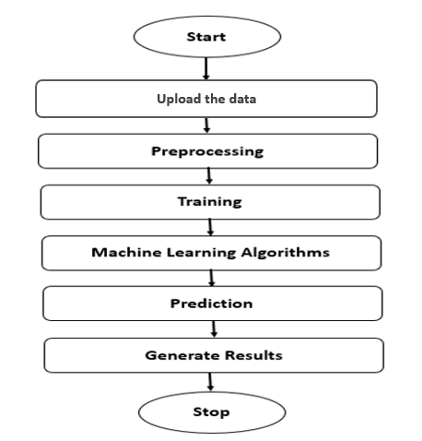
PROPOSED METHOD

Slide 13
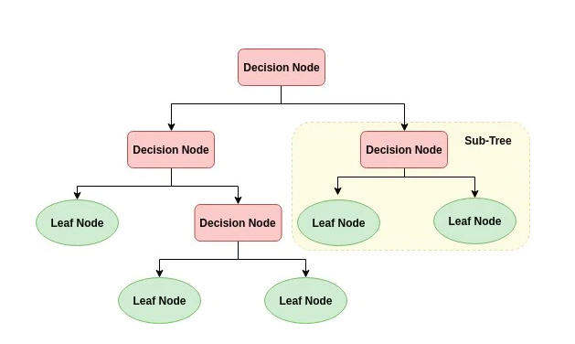
ALGORITHMS
Decision Tree:
Decision tree is a flowchart-like tree structure where an internal node represents feature(or attribute), the branch represents a decision rule, and each leaf node represents the outcome. The topmost node in a decision tree is known as the root node. It learns to partition on the basis of the attribute value. It partitions the tree in recursively manner call recursive partitioning. This flowchart-like structure helps you in decision making. It's visualization like a flowchart diagram which easily mimics the human level thinking. That is why decision trees are easy to understand and interpret.

Slide 14
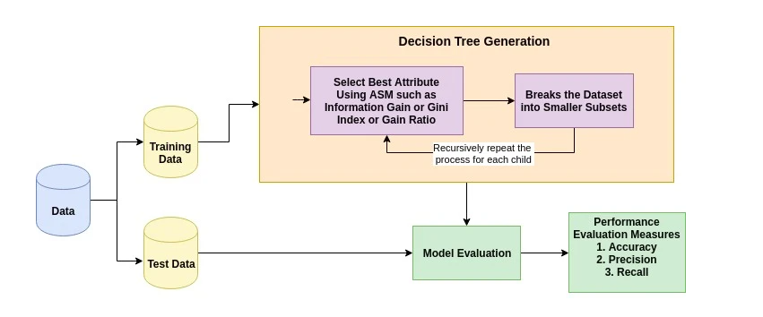
The basic idea behind any decision tree algorithm is as follows:
Select the best attribute using Attribute Selection Measures (ASM) to split the records.
Make that attribute a decision node and breaks the dataset into smaller subsets.
Starts tree building by repeating this process recursively for each child until one of the conditions will match:
All the tuples belong to the same attribute value.
There are no more remaining attributes.
There are no more instances.

Slide 15
2. EXTRA TREE CLASSIFIER:
Extra Trees Classifier is an ensemble learning method fundamentally based on decision trees. Extra Trees Classifier, like Random Forest, randomizes certain decisions and subsets of data to minimize over-learning from the data and over fitting. Let’s look at some ensemble methods ordered from high to low variance, ending in Extra Trees Classifier.
Decision Tree (High Variance)
A single decision tree is usually overfits the data it is learning from because it learn from only one pathway of decisions. Predictions from a single decision tree usually don’t make accurate predictions on new data.
Random Forest (Medium Variance)
Random forest models reduce the risk of overfitting by introducing randomness by:
• building multiple trees (n_estimators)
• drawing observations with replacement (i.e., a bootstrapped sample)
• splitting nodes on the best split among a random subset of the features selected at every node

Slide 16
3. RANDOM FOREST CLASSIFIER:
A random forest is a machine learning technique that’s used to solve regression and classification problems. It utilizes ensemble learning, which is a technique that combines many classifiers to provide solutions to complex problems.
A random forest algorithm consists of many decision trees. The ‘forest’ generated by the random forest algorithm is trained through bagging or bootstrap aggregating. Bagging is an ensemble meta-algorithm that improves the accuracy of machine learning algorithms.
The (random forest) algorithm establishes the outcome based on the predictions of the decision trees. It predicts by taking the average or mean of the output from various trees. Increasing the number of trees increases the precision of the outcome.
A random forest eradicates the limitations of a decision tree algorithm. It reduces the over fitting of datasets and increases precision. It generates predictions without requiring many configurations in packages (like Scikit-learn).

Slide 17
Features of a Random Forest Algorithm:
It’s more accurate than the decision tree algorithm.
It provides an effective way of handling missing data.
It can produce a reasonable prediction without hyper-parameter tuning.
It solves the issue of over fitting in decision trees.
In every random forest tree, a subset of features is selected randomly at the node’s splitting point.
Decision trees are the building blocks of a random forest algorithm. A decision tree is a decision support technique that forms a tree-like structure. An overview of decision trees will help us understand how random forest algorithms work.
A decision tree consists of three components: decision nodes, leaf nodes, and a root node. A decision tree algorithm divides a training dataset into branches, which further segregate into other branches. This sequence continues until a leaf node is attained. The leaf node cannot be segregated further.
The nodes in the decision tree represent attributes that are used for predicting the outcome. Decision nodes provide a link to the leaves. The following diagram shows the three types of nodes in a decision tree.

Slide 18
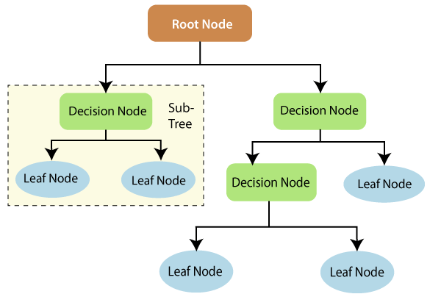
The information theory can provide more information on how decision trees work. Entropy and information gain are the building blocks of decision trees. An overview of these fundamental concepts will improve our understanding of how decision trees are built.
Entropy is a metric for calculating uncertainty. Information gain is a measure of how uncertainty in the target variable is reduced, given a set of independent variables.
The information gain concept involves using independent variables (features) to gain information about a target variable (class). The entropy of the target variable (Y) and the conditional entropy of Y (given X) are used to estimate the information gain. In this case, the conditional entropy is subtracted from the entropy of Y.

Slide 19
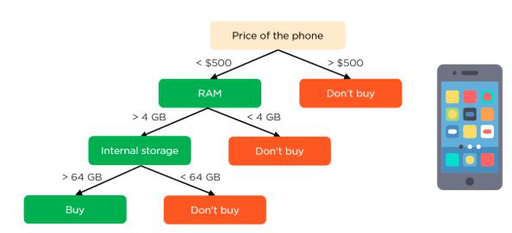
Information gain is used in the training of decision trees. It helps in reducing uncertainty in these trees. A high information gain means that a high degree of uncertainty (information entropy) has been removed. Entropy and information gain are important in splitting branches, which is an important activity in the construction of decision trees.
Let’s take a simple example of how a decision tree works. Suppose we want to predict if a customer will purchase a mobile phone or not. The features of the phone form the basis of his decision. This analysis can be presented in a decision tree diagram.
The root node and decision nodes of the decision represent the features of the phone mentioned above. The leaf node represents the final output, either buying or not buying. The main features

Slide 20
3. Neural Network:
An artificial neural network (ANN) is the piece of a computing system designed to simulate the way the human brain analyzes and processes information. It is the foundation of artificial intelligence (AI) and solves problems that would prove impossible or difficult by human or statistical standards. ANNs have self-learning capabilities that enable them to produce better results as more data becomes available.
An ANN has hundreds or thousands of artificial neurons called processing units, which are interconnected by nodes. These processing units are made up of input and output units. The input units receive various forms and structures of information based on an internal weighting system, and the neural network attempts to learn about the information presented to produce one output report. Just like humans need rules and guidelines to come up with a result or output, ANNs also use a set of learning rules called backpropagation, an abbreviation for backward propagation of error, to perfect their output results.
An ANN initially goes through a training phase where it learns to recognize patterns in data, whether visually, aurally, or textually. During this supervised phase, the network compares its actual output produced with what it was meant to produce—the desired output. The difference between both outcomes is adjusted using backpropagation.

Slide 21
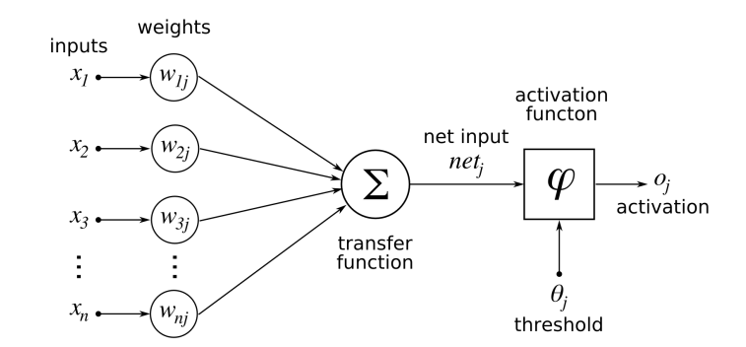
This means that the network works backward, going from the output unit to the input units to adjust the weight of its connections between the units until the difference between the actual and desired outcome produces the lowest possible error.
Whenever we increase the layers in our ANN then it is nothing but our Deep Neural Networks.
A deep neural network (DNN) is an artificial neural network (ANN) with multiple layers between the input and output layers. There are different types of neural networks but they always consist of the same components: neurons, synapses, weights, biases, and functions.

Slide 22
HARDWARE AND SOFTWARE REQUIREMENTS
H/W Configuration:
Operating system : Windows 7 or 7+
RAM : 8 GB
Hard disc or SSD : More than 500 GB
Processor : Intel 3rd generation or high or Ryzen with 8 GB Ram
S/W Configuration:
Software’s : Python 3.6 or high version
IDE : PyCharm.
Framework : Flask

Slide 23
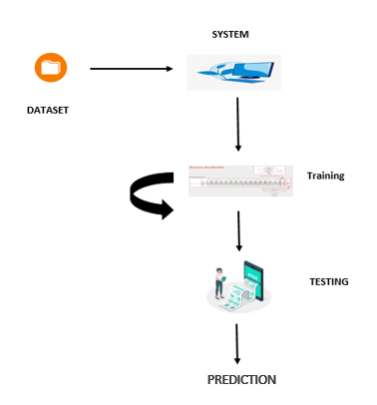
ARCHITECTURE:

Slide 24
UML DIAGRAMS
UML stands for Unified Modelling Language. UML is a standardized general-purpose modelling language in the field of object-oriented software engineering. The standard is managed, and was created by, the Object Management Group.
The goal is for UML to become a common language for creating models of object-oriented computer software. In its current form UML is comprised of two major components: a Meta-model and a notation. In the future, some form of method or process may also be added to; or associated with, UML.
The Unified Modelling Language is a standard language for specifying, Visualization, Constructing and documenting the artefacts of software system, as well as for business modelling and other non-software systems. The UML represents a collection of best engineering practices that have proven successful in the modelling of large and complex systems.
The UML is a very important part of developing objects-oriented software and the software development process. The UML uses mostly graphical notations to express the design of software projects.

Slide 25
GOALS:
The Primary goals in the design of the UML are as follows:
Provide users a ready-to-use, expressive visual modelling Language so that they can develop and exchange meaningful models.
Provide extendibility and specialization mechanisms to extend the core concepts.
Be independent of particular programming languages and development process.
Provide a formal basis for understanding the modelling language.
Encourage the growth of OO tools market.
Support higher level development concepts such as collaborations, frameworks, patterns and components.
Integrate best practices.

Slide 26
USE CASE DIAGRAM
A use case diagram in the Unified Modeling Language (UML) is a type of behavioral diagram defined by and created from a Use-case analysis.
Its purpose is to present a graphical overview of the functionality provided by a system in terms of actors, their goals (represented as use cases), and any dependencies between those use cases.
The main purpose of a use case diagram is to show what system functions are performed for which actor. Roles of the actors in the system can be depicted.

Slide 27
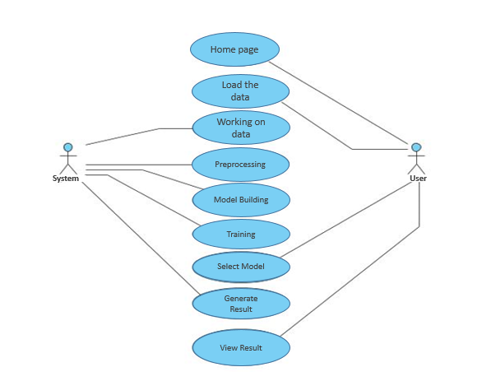

Slide 28
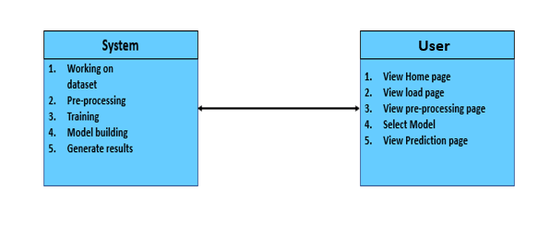
CLASS DIAGRAM
In software engineering, a class diagram in the Unified Modeling Language (UML) is a type of static structure diagram that describes the structure of a system by showing the system's classes, their attributes, operations (or methods), and the relationships among the classes. It explains which class contains information

Slide 29
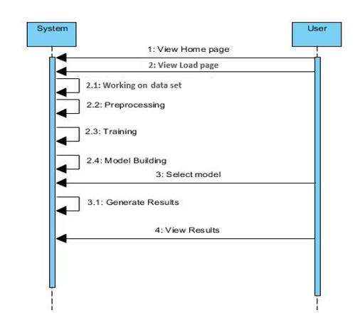
SEQUENCE DIAGRAM
A sequence diagram in Unified Modeling Language (UML) is a kind of interaction diagram that shows how processes operate with one another and in what order.
It is a construct of a Message Sequence Chart. Sequence diagrams are sometimes called event diagrams, event scenarios, and timing diagrams

Slide 30
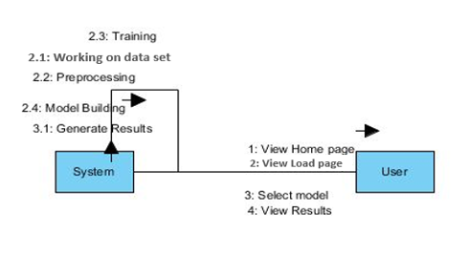
COLLABORATION DIAGRAM:
In collaboration diagram the method call sequence is indicated by some numbering technique as shown below. The number indicates how the methods are called one after another. We have taken the same order management system to describe the collaboration diagram. The method calls are similar to that of a sequence diagram. But the difference is that the sequence diagram does not describe the object organization whereas the collaboration diagram shows the object organization.

Slide 31
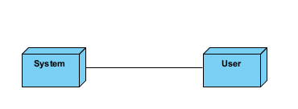
DEPLOYMENT DIAGRAM
Deployment diagram represents the deployment view of a system. It is related to the component diagram. Because the components are deployed using the deployment diagrams. A deployment diagram consists of nodes. Nodes are nothing but physical hardware’s used to deploy the application.

Slide 32
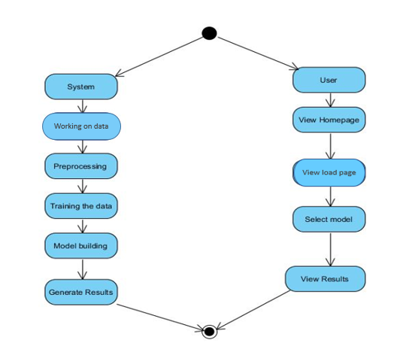
ACTIVITY DIAGRAM:
Activity diagrams are graphical representations of workflows of stepwise activities and actions with support for choice, iteration and concurrency. In the Unified Modelling Language, activity diagrams can be used to describe the business and operational step-by-step workflows of components in a system. An activity diagram shows the overall flow of control.

Slide 33
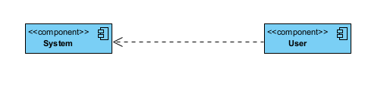
COMPONENT DIAGRAM:
A component diagram, also known as a UML component diagram, describes the organization and wiring of the physical components in a system. Component diagrams are often drawn to help model implementation details and double-check that every aspect of the system's required function is covered by planned development.

Slide 34
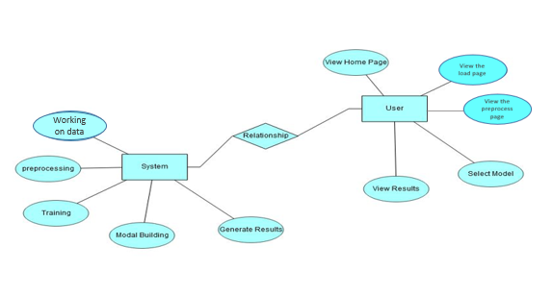
ER DIAGRAM:
An Entity–relationship model (ER model) describes the structure of a database with the help of a diagram, which is known as Entity Relationship Diagram (ER Diagram). An ER model is a design or blueprint of a database that can later be implemented as a database. The main components of E-R model are: entity set and relationship set.
An ER diagram shows the relationship among entity sets. An entity set is a group of similar entities and these entities can have attributes. In terms of DBMS, an entity is a table or attribute of a table in database, so by showing relationship among tables and their attributes, ER diagram shows the complete logical structure of a database. Let’s have a look at a simple ER diagram to understand this concept.

Slide 35
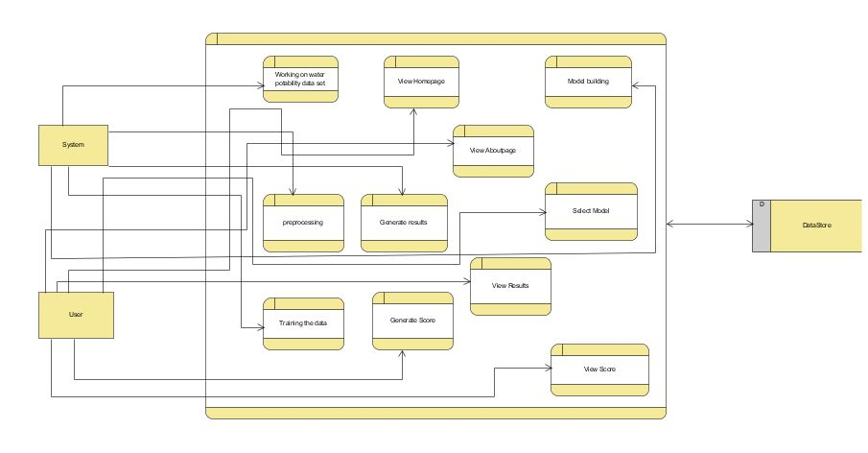
DFD DIAGRAM:
A Data Flow Diagram (DFD) is a traditional way to visualize the information flows within a system. A neat and clear DFD can depict a good amount of the system requirements graphically. It can be manual, automated, or a combination of both. It shows how information enters and leaves the system, what changes the information and where information is stored. The purpose of a DFD is to show the scope and boundaries of a system as a whole. It may be used as a communications tool between a systems analyst and any person who plays a part in the system that acts as the starting point for redesigning a system.

Slide 36
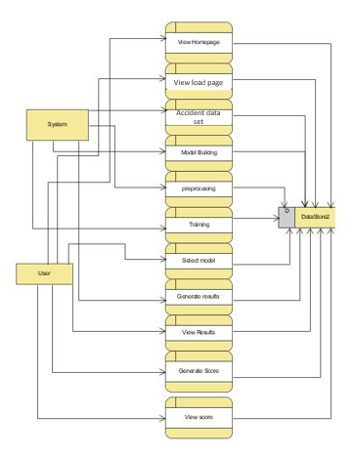

Slide 37

OUTPUT SCREEN SHOTS WITH DESCRIPTION.
Home Page:
Here user view the home page of cyber-attack web application.

Slide 38

ABOUT:
Here we can read about our project.

Slide 39

Register:
In the page, users need to register by entering his credentials.

Slide 40

Log in:
In the page, users has to enter the credentials to enter into the cyber-attack prediction.

Slide 41

Load:
In the load page, users can load the cyber dataset.

Slide 42
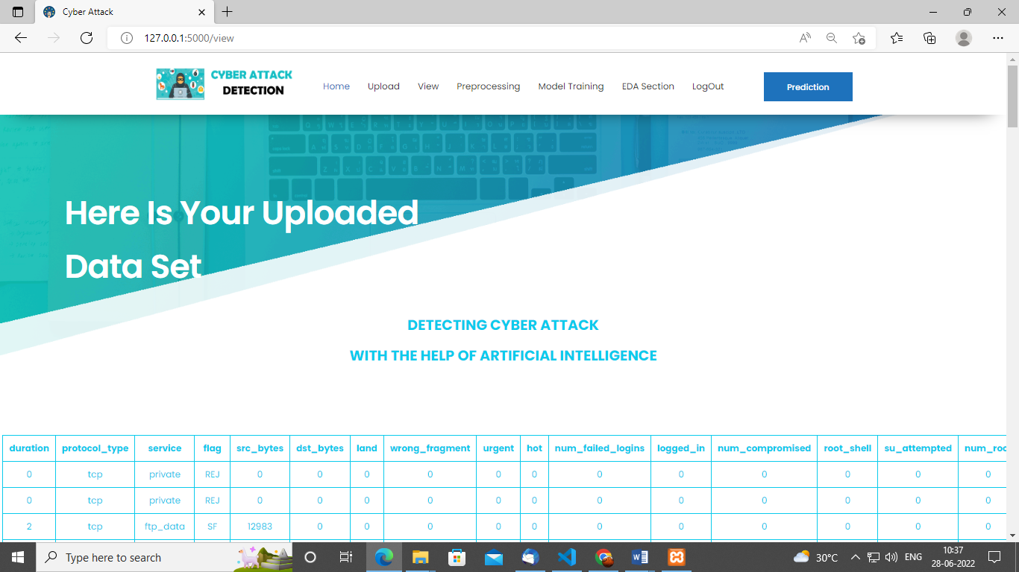
View:
Here we can see the uploaded data set.

Slide 43

Pre-process:
Here we can pre-process and splits our data into train and testing .

Slide 44
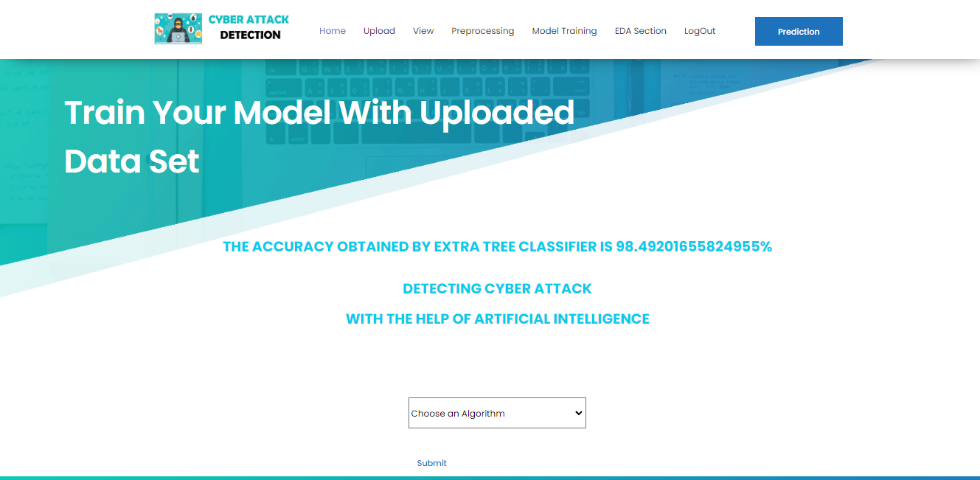
Model:
Here we can train our data using different algorithm.

Slide 45

Prediction:
This page show the detection result of the cyber-attack detection data.

Slide 46
CONCLUSION:
In this study, an attempt was made to use the resilient control consensus method in complex discrete cyber-physical networks with a number of local attacks off. By applying this control method, it was observed that even in the presence of cyber-attacks, the system can remain stable and isolate the attacked node and the performance of the system is not weakened. Using the neural network used in this study, it was observed that with a deep neural network, with 7 hidden layers, the system shows better performance. Also in a recurrent neural network integrated with a deep neural network, a deep layer network with a linear function performs better. Therefore, it can be said that the system has less complexity. So With deep learning method, systems can analyse patterns and learn from them to help prevent similar attacks and respond to changing behaviour. In short, machine learning can make cyber security simpler, more proactive, less expensive and far more effective. After observing the state of the system reported by the neural network, the control system makes decisions based on it and, if there is an attack, detects it and isolates it, so as not to have a detrimental effect on the behaviour of other agents. In future research, more attacks on agents can be considered, also data mining and other machine learning methods, such as support vector machine (SVM) algorithms or other types of neural networks such as recurrent neural networks to evaluate system performance improvements.

Slide 47
FUTURE SCOPE
There are quite a few things that can be polished or be added in the future work. • We have opted to use two data mining classifies in this project namely the ID3 and Naive Bayes classifier. There are more classifires such as the Bayesian network classifier, Neural Network classifier and C4.5 classifier. Such classifiers were not included in this paper and could be counted in future to give a more data to be compared with.

Slide 48
REFERENCES:
[1] Kwon, Cheolhyeon, Weiyi Liu, and Inseok Hwang. ”Security analysis for cyber-physical systems against stealthy deception attacks.” In 2013 American control conference, IEEE (2013): 3344-3349.
[2] Pajic, Miroslav, James Weimer, Nicola Bezzo, Oleg Sokolsky, George J. Pappas, and Insup Lee. ”Design and implementation of attack-resilient cyberphysical systems: With a focus on attack-resilient state estimators.” IEEE Control Systems Magazine 37, no. 2 (2017): 66-81.
[3] Sheng, Long, Ya-Jun Pan, and Xiang Gong. ”Consensus formation control for a class of networked multiple mobile robot systems.” Journal of Control Science and Engineering 2012 (2012).
[4] Zeng, Wente, and Mo-Yuen Chow. ”Resilient distributed control in the presence of misbehaving agents in networked control systems.” IEEE transactions on cybernetics 44, no. 11 (2014): 2038-2049.
[5] Sun, Hongtao, Chen Peng, Taicheng Yang, Hao Zhang, and Wangli He. ”Resilient control of networked control systems with stochastic denial of service attacks.” Neurocomputing 270 (2017): 170-177.

Slide 49
[6] Zhang, Haotian, and Shreyas Sundaram. ”Robustness of information diffusion algorithms to locally bounded adversaries.” In 2012 American Control Conference (ACC), IEEE (2012): 5855-5861.
[7] Fu, Weiming, Jiahu Qin, Yang Shi, Wei Xing Zheng, and Yu Kang. ”Resilient Consensus of Discrete-Time Complex Cyber-Physical Networks under Deception Attacks.” IEEE Transactions on Industrial Informatics (2019).
[8] Ozay, Mete, Inaki Esnaola, Fatos Tunay Yarman Vural, Sanjeev R. Kulkarni, and H. Vincent Poor. ”Machine learning methods for attack detection in the smart grid.” IEEE transactions on neural networks and learning systems 27, no. 8 (2015): 1773-1786.
[9] Tianfield, Huaglory. ”Data mining based cyber-attack detection.” System simulation technology 13, no. 2 (2017): 90-104.
[10] Pasqualetti, Fabio, Florian Dorfler, and Francesco Bullo. ”Attack detection and ¨ identification in cyber-physical systems.” IEEE Transactions on Automatic Control 58, no. 11 (2013): 2715-2729.

Slide 50


